Slide 1
Cyber Incident Primer
BCCSA Conference Presentation Chris Law, Partner, National Leader, Cyber Security Incident Management
Oct 21, 2022

Slide 2
Today’s Agenda
Cyber Incident Trends
What happens during a cyber incident
Cyber Insurance
What you can do with your organization to best prepare for a cyber incident

Slide 3
Cybersecurity Ventures predicts ransomware will cost its victims more than $265 Billion USD annually by 2031
In the last 90 days…. the MNP team is dealing with the following incidents in Canada
Fraudulent Electronic Fund Transfers across all sectors/verticals, especially Retail and Construction, Building Supply
Ransomware – 2M – 10M
Individual theft by less sophisticated threat actors for smaller amounts
Denial of Service Attacks against Supply Chain and Natural Resources

Slide 4
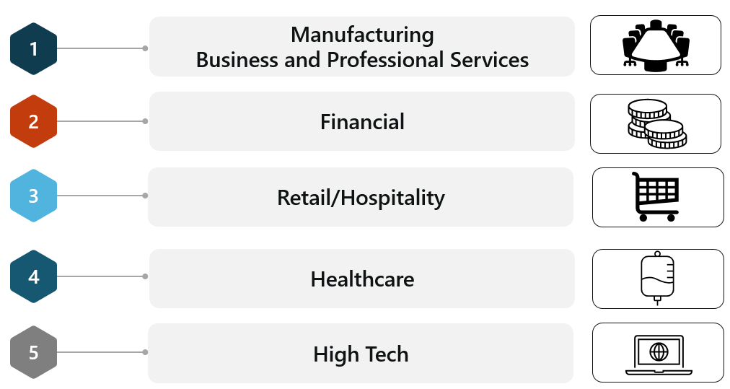
What verticals are most targeted?

Slide 5
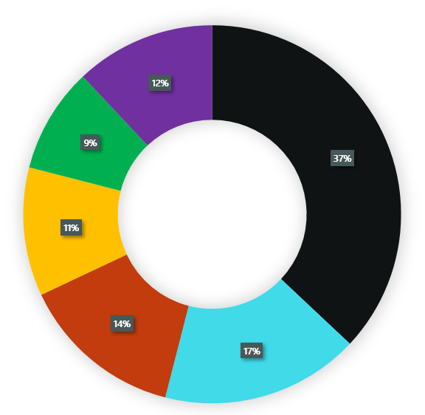
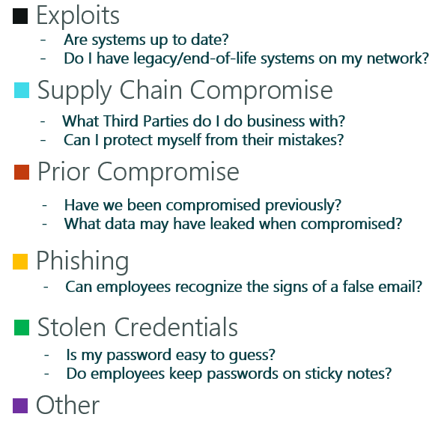
Where organizations are most targeted?

Slide 6
Common Points of Access
How does it happen? Common Points of Entry…
Vulnerable Applications
Attackers can take advantage of vulnerable systems and applications that have not been patched or a patch has been released
Malware
Users download malware to their system without knowledge of it after visiting an infected website.
Insider Threat
Although less common, it does happen where disgruntled employees may assist a threat actor with launching an attack.
Phishing Emails
Tailored phishing campaigns have become more advanced and tailored to the environment or person the attacker is targeting
Credential Theft
Attackers can either brute force (attempt multiple passwords to access system or server), most often to remote users or purchase credential information online to attempt initial access
3rd Party Services
Cloud Service providers and partners may be the source of the compromise and spread to your organization’s infrastructure given their established and elevated access.
Unauthorized Devices and Software
IOT, Social Media, and other convenient devices installed by employees

Slide 7
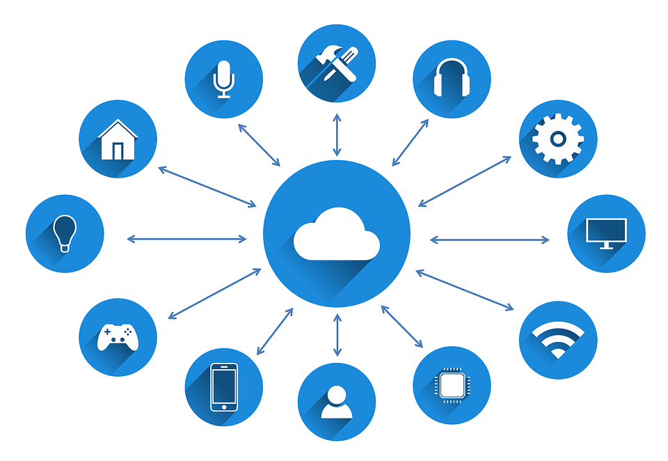
Increasing Interconnection: The Internet of Things (IoT)
Security is often not a priority for vendors
of emerging interconnected devices, but
they are still a foothold into a network
Internet Connected
Sensors
Cameras
Coffee Machines
Cars
Entertainment/COVID retention devices deployed by employees

Slide 8
Common Misconceptions for Non-action
Everything is backed up
Have you tested your backups?
Are your backups also infected? Or even protected?
My data is safe in the cloud
Highest source of malicious attacks is misconfigured cloud implementations
We have cyber insurance
Have you reviewed all the terms and conditions and what-if scenarios, claims are heavily scrutinized
I don’t have anything valuable to steal
It is just abut the weakest link.
How about the cost of taking you out of business?

Slide 9
Cyber Insurance
Types of cyber insurance
First Party | Incident Response | Covers your expenses in the event of a network security failure, including data breach, malware, cyber extortion, ransomware, or business email compromise.
 | Ransom | Negotiation and payment of ransom
 | Business Interruption | When your network or computer system goes down, you can recover lost profits, fixed expenses, and extra expenses incurred during the time your business was affected.
Third Party | Security Liability | Covers claims to you arising from: Transmission of malware to third party system, your system being used to carry out a service attack and identity theft
 | Privacy Liability | Covers sensitive customer and employee information data thefts, compromise and failure to notify individuals
Add-On’s | Reputational Harm | Due to the cyber event, either your company or your brand has lost reputational value, and as a result customers are going to competitors.
 | Computer Replacement | Due to the cyber event, your computer equipment may be permanently damaged, and needs to be replaced.
 | Social Engineering | Business Compromised Emails (“Spoofing”) may be designed to have employees transfer large amounts of money, pay bogus vendors, or otherwise transfer money from the company’s bank account to the hackers.

Slide 10
10 Step Incident Response Action Plan
01
Triage: Establish rules of engagement with insurance and external counsel
06
Execution: Execute with purpose and be deliberate with actions, time is of the essence, document the risk, and reach agreement, and validate actions
02
War-Room: Establish communications, assign roles, war-room, report cadence, begin journal
07
Analysis: Malware analysis to pull apart the malware, analyze, and sandbox, Threat Risk team to research similar actions, threat actor background
03
Identify and Align: review/educate Board, Executives on the incident, threat actors, ransomware process, ramifications of payment, decision trees, crown jewels, other cases
08
Root Cause Analysis: investigate/determine root cause, collect, archive evidence, ensure chain of custody
04
Communication: Review and remind the collaborative team on communication, actions, protocols, documentation, and the human element – make sure we take care of each other
09
Regulations: Regulatory reporting, privacy if data has been exfiltrated, ensure communications, evidence is vetted by counsel
05
Containment: Gain visibility by deploying endpoints, aggregate as many log sources as possible within the environment, enhance monitoring
10
Reporting: Defensibility report on exhaustive efforts, validate findings, point in time, identify gaps, and build in resiliency to facilitate defense against future claims, litigation, and reputational issues

Slide 11
Know your crown jewels!
1. Identify Crown Jewels
Know what is really important to your business – don’t try to protect everything.
3. Business Resilience
If all your systems went away tonight and you must start with brand new blank ones tomorrow, could you re-start your business within a couple of weeks?
Cyber Resilience
2. Data Identification
What information are you using? Think the what, why, how, where, and when of all your data?

Slide 12
Know your partners and 3rd party suppliers
In the last few months, it was the organizations’ third-party IT or other supplier that caused 60% of the cyber incidents that MNP has been engaged.
Ask them for independent reports of their cybersecurity assessments
Understand the risk of accessing your systems if they are compromised
Have legal clauses within your procurement process to further protect your organization to determine where coverage/liability starts and ends
Determine if 24/7 access is necessary – determine if multiple providers make sense
Determine what insurance coverage is necessary

Slide 13
What saves or destroys a business…
Staff/Employee Security Awareness Training – the most cost effective and the first line of defense
Backups – Focus on critical data, test backups regularly, and have offline copies
Multi-Factor Authentication – Fundamental, table stakes – annoying but critical
Logs and Monitoring – Implement systems to detect incidents before they become breaches
Incident Preparedness – Develop an incident response plan (including decision trees for ransomware) and prepare your business by practicing incident scenarios – it’s not just IT but board members and executives
Offline Information – Critical plans, contacts, inventory lists kept offline and updated regularly

Slide 14
Stress is real…no need to be a hero…
Avoid hero mentality, as the incident continues, poor decisions and mistakes increase by key resources – enforce shifts and mandatory rest
Remember to take care of the root cause, don’t ignore the elephant in the room
A growing concern is the mental stress for all involved, do not forget about your employees while dealing with clients and the public

Slide 15
You are not in this alone…
Do not hesitate to bring in the experts
During an incident, your competitors will become your friend and your saviour
Privacy commissioners are there to assist via your counsel, they want to know how many records, and likelihood of actions against affected parties

Slide 16
Thank you!
Christopher Law
chris.law@mnp.ca

Slide 17
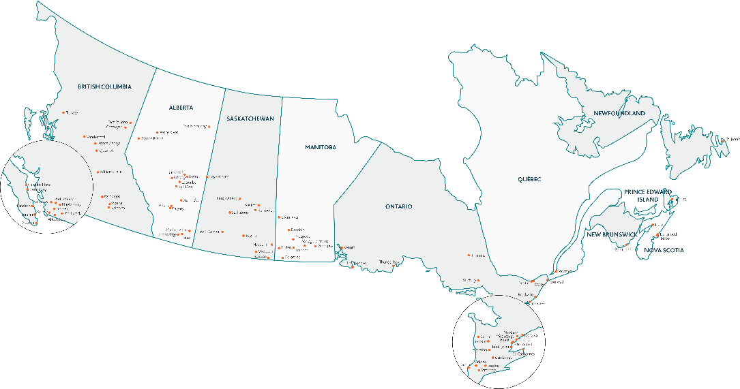
MNP
Proudly Canadian with enterprise-class capabilities
For over 60 years, MNP has proudly served and responded to the needs of clients in the public, private and not-for-profit sectors. We customize every engagement to meet the specific needs of our clients. By having local, regional and national expertise in all our markets, we are able to provide clients with partner-led projects, which ensure an efficient approach to engagements. We streamline processes to facilitate high-caliber deliverables and solutions that exactly meet our clients’ needs.
MNP is the fastest growing and the 5th largest accounting, tax and consulting firm in Canada.
5,700+
Total Team
Members
2,154+
Total CPAs
960+
Partners
125+
Offices

Slide 18
Our Clients
Financial Institutions
Critical Infrastructure
First Nations and other Indigenous
Government
Healthcare
Education
Mining and Resources
Technology and Telecommunications
Cyber Security & Privacy
Minimize threats and proactively protect your most valuable assets.
What we do
Security Architecture
Risk Management
Privacy & Data Protection
Offensive Security
Incident Management
Cyber (SOC) Managed Services

